Slide 1
BASIC OPERATION
https://github.com/jleetutorial/sparkTutorial/blob/winutils/winutils.exe..
https://github.com/Manish4hadoop/SPARK-JAVA

Slide 2
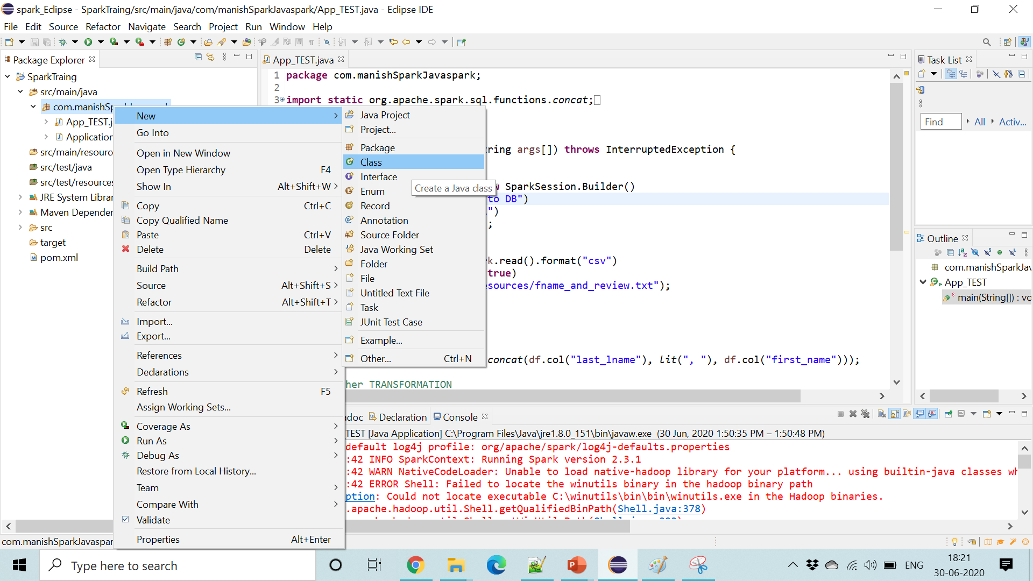

Slide 3
<!-- https://mvnrepository.com/artifact/log4j/log4j -->
<dependency>
<groupId>log4j</groupId>
<artifactId>log4j</artifactId>
<version>1.2.16</version>
</dependency>

Slide 4
public class Rdd_Demo_1 {
public static void main(String args[]) throws InterruptedException {
List<Double> input_data=new ArrayList<>();
input_data.add(20.5);
input_data.add(21.5);
input_data.add(22.5);
input_data.add(23.5);
input_data.add(24.5);
input_data.add(25.5);
Logger.getLogger("org.apache").setLevel(Level.WARN);
SparkConf conf = new SparkConf().setAppName("startingSpark").setMaster("local[*]");
JavaSparkContext sc = new JavaSparkContext(conf);
JavaRDD<Double> myRdd = sc.parallelize(input_data);
Double result=myRdd.reduce((value1,value2)-> value1 +value2);
System.out.print(result);
sc.close();
}
}

Slide 5
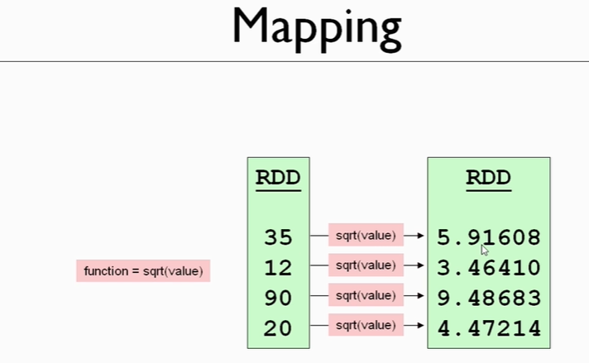
MAP

Slide 6
package com.manishSparkJavaspark;
import java.util.ArrayList;
import java.util.List;
import org.apache.log4j.Level;
import org.apache.log4j.Logger;
import org.apache.spark.SparkConf;
import org.apache.spark.api.java.JavaRDD;
import org.apache.spark.api.java.JavaSparkContext;
public class Map_2_Sqrt {
public static void main(String args[]) throws InterruptedException {
List<Integer> input_data=new ArrayList<>();
input_data.add(20);
input_data.add(21);
input_data.add(22);
input_data.add(23);
input_data.add(24);
input_data.add(25);
Logger.getLogger("org.apache").setLevel(Level.WARN);
SparkConf conf = new SparkConf().setAppName("startingSpark").setMaster("local[*]");
JavaSparkContext sc = new JavaSparkContext(conf);
JavaRDD<Integer> myRdd = sc.parallelize(input_data);
Integer result=myRdd.reduce((value1,value2)-> value1 +value2);
JavaRDD<Double> SqrtRdd = myRdd.map((value)->Math.sqrt(value));
SqrtRdd.foreach(value->System.out.println(value));
//New Way of Foreach in Java 1.8 is
//SqrtRdd.foreach(System.out::println);
System.out.print(result);
sc.close();
}
}

Slide 7
How to Count No of Elemets in RDD
//How to Count How many Elements are There in RDD
System.out.print(SqrtRdd.count());

Slide 8
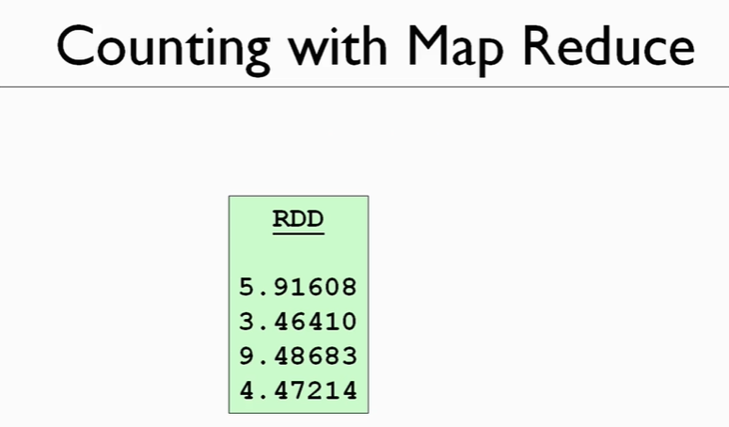

Slide 9
// how many elements in sqrtRdd
// using just map and reduce
JavaRDD<Long> singleIntegerRdd = sqrtRdd.map( value -> 1L);
Long count = singleIntegerRdd.reduce((value1, value2) -> value1 + value2);
System.out.println(count);

Slide 10
NOT SERIALIZATION ERROR
//New Way of Foreach in Java 1.8 is
//SqrtRdd.foreach(System.out::println);
System.out.print(result);

Slide 11
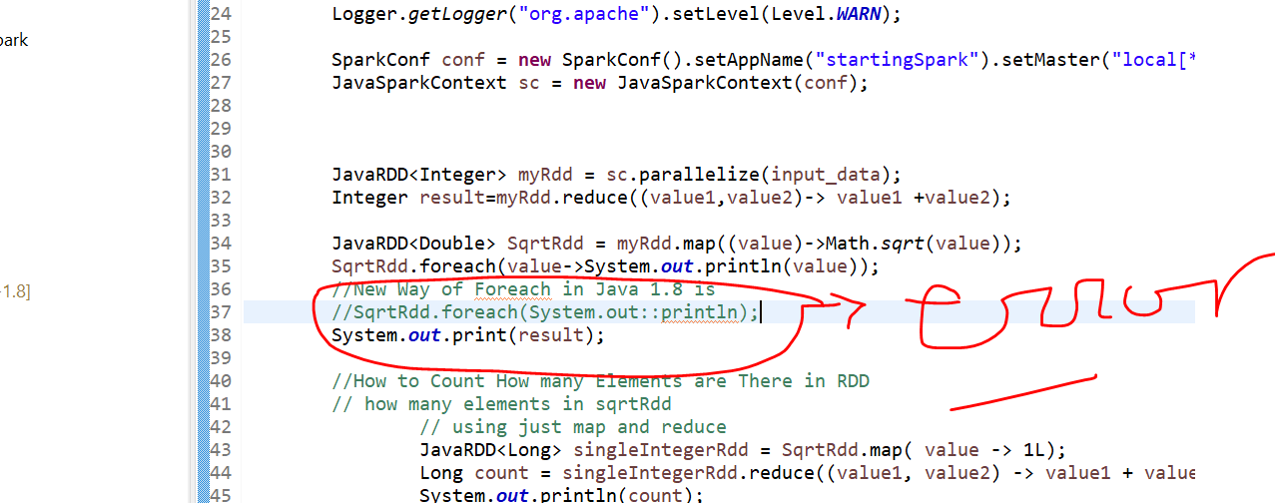

Slide 12
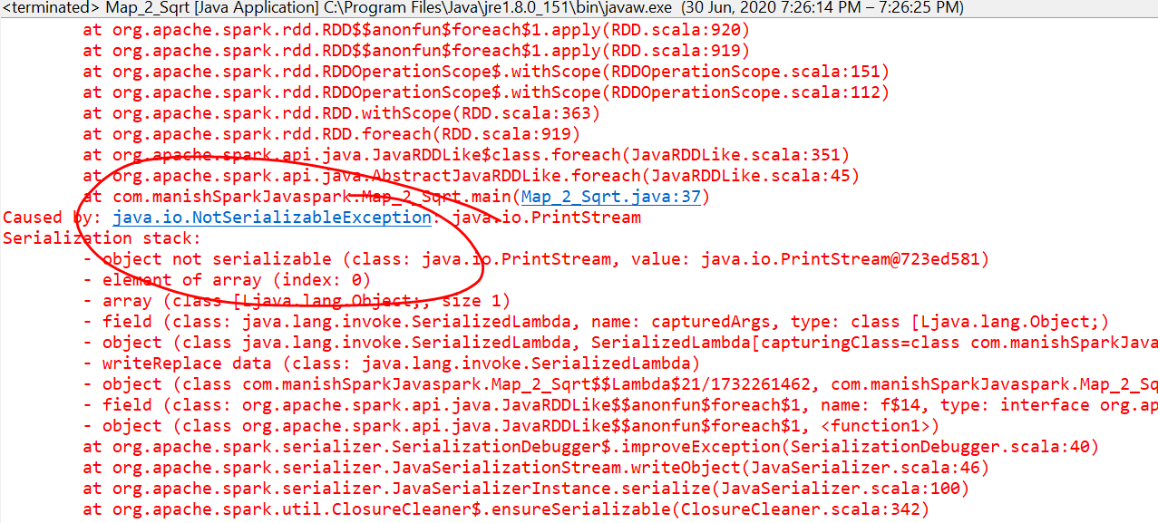

Slide 13
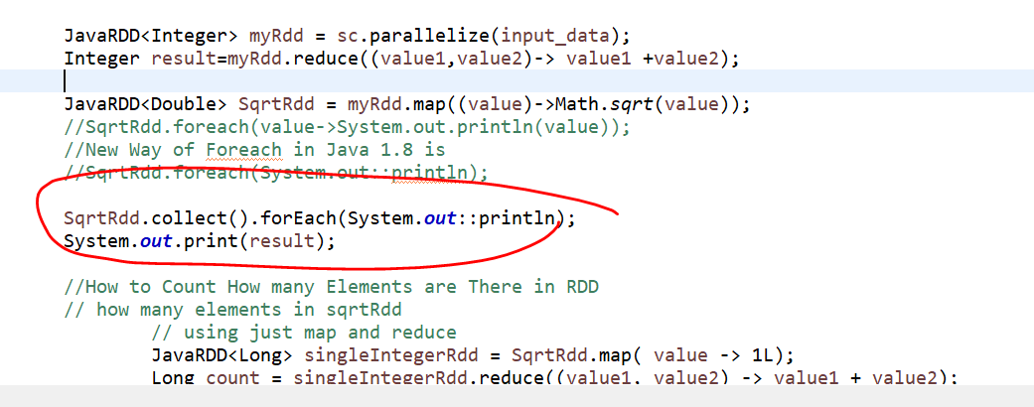

Slide 14
TUPLE
public static void main(String[] args)
{
List<Integer> inputData = new ArrayList<>();
inputData.add(35);
inputData.add(12);
Logger.getLogger("org.apache").setLevel(Level.WARN);
SparkConf conf = new SparkConf().setAppName("startingSpark").setMaster("local[*]");
JavaSparkContext sc = new JavaSparkContext(conf);
JavaRDD<Integer> originalIntegers = sc.parallelize(inputData);
JavaRDD<Tuple2<Integer, Double>> sqrtRdd = originalIntegers.map( value -> new Tuple2<>(value, Math.sqrt(value)) );
new Tuple5(4, 3, 2, 1, 2);
new Tuple23()
sc.close();
}

Slide 15
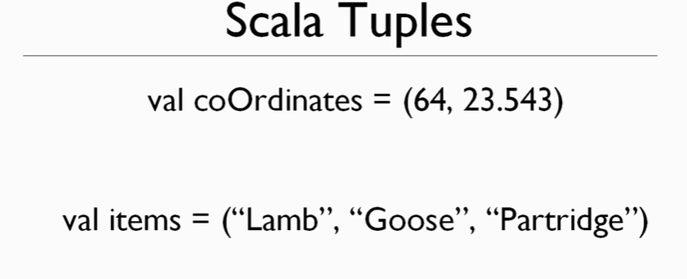
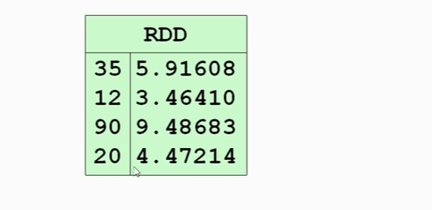

Slide 17
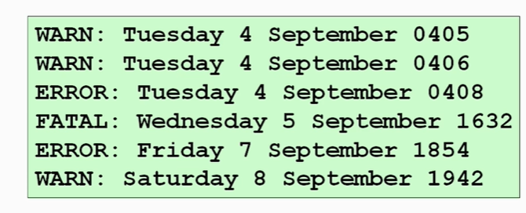
PAIR RDD
Count No of Warning.No of Error ??

Slide 18
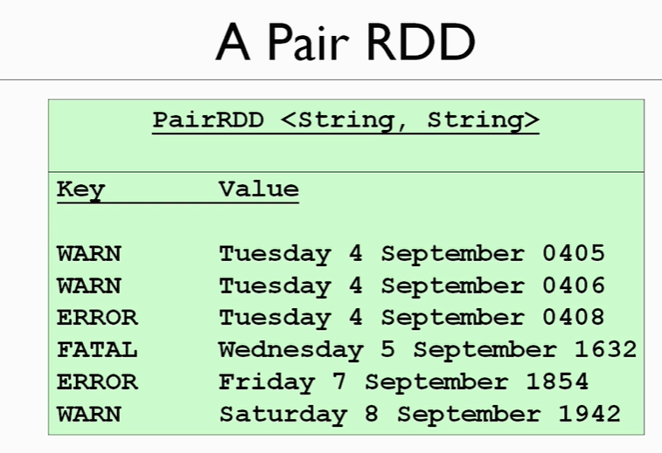

Slide 19
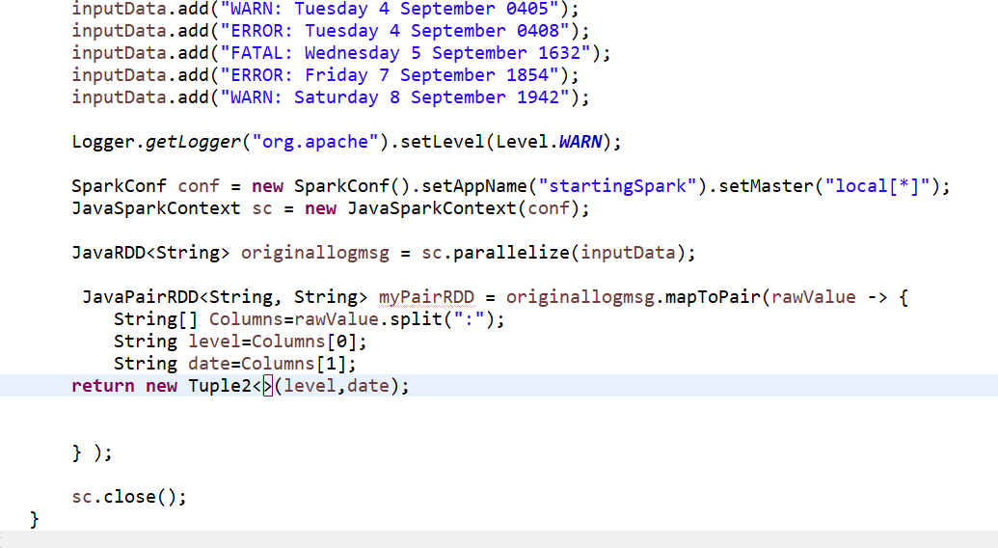

Slide 20
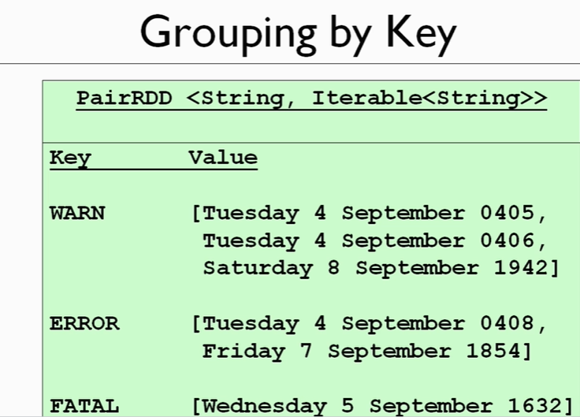

Slide 21
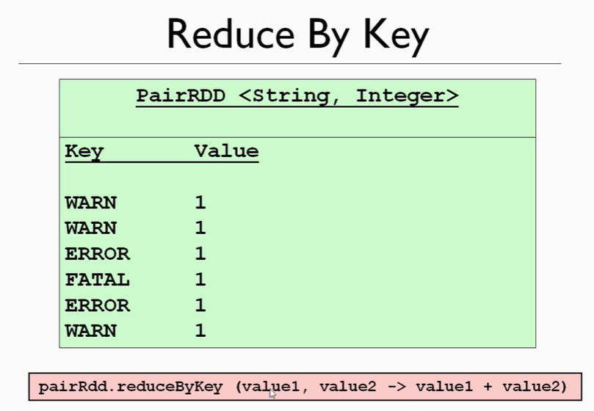

Slide 22
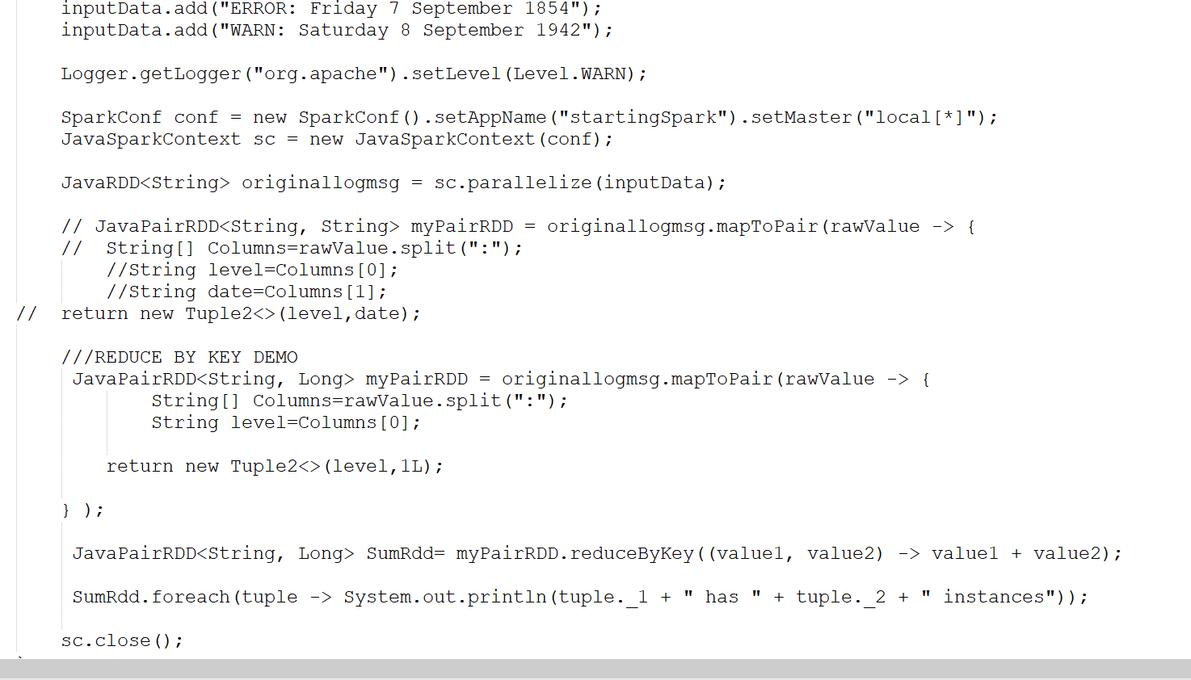

Slide 23
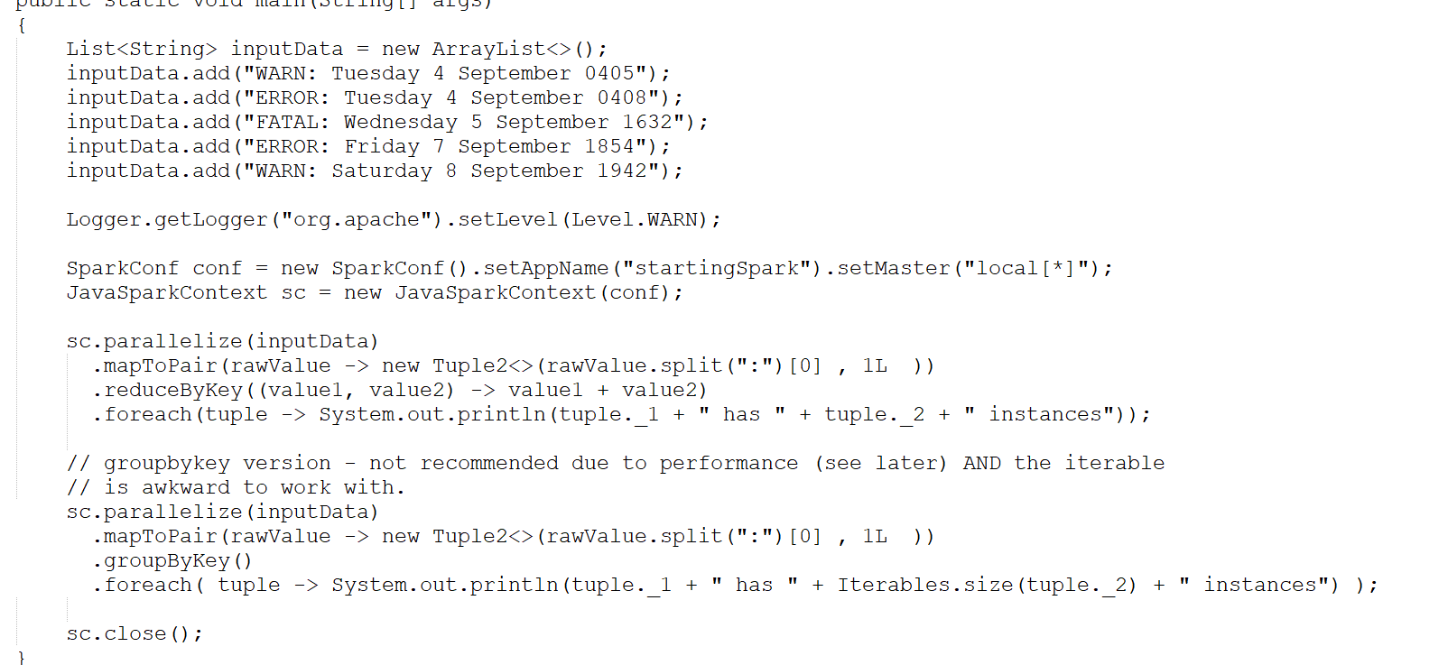
or

Slide 24
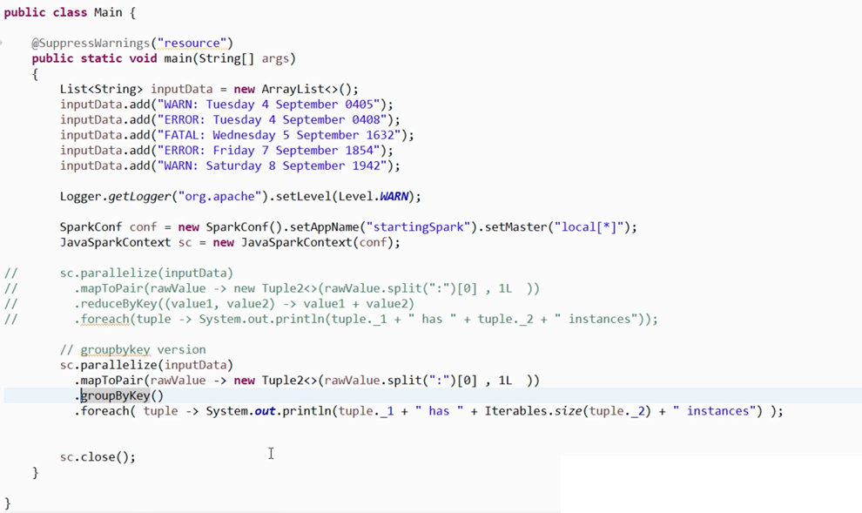
GROUP BY KEY

Slide 25
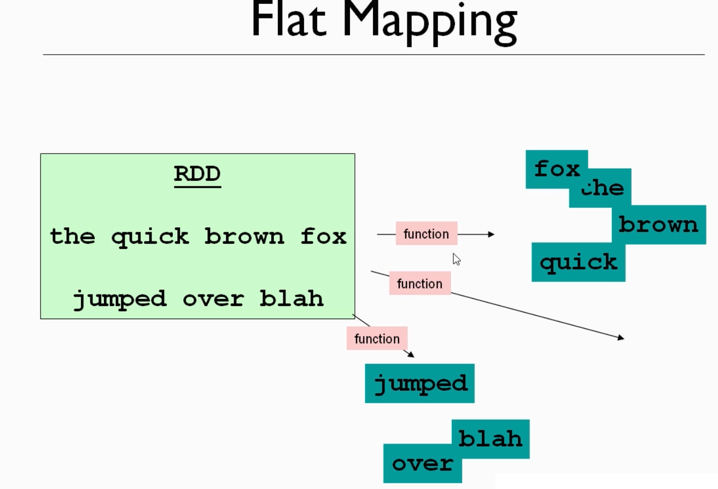
FLATMAP &fILTER

Slide 26
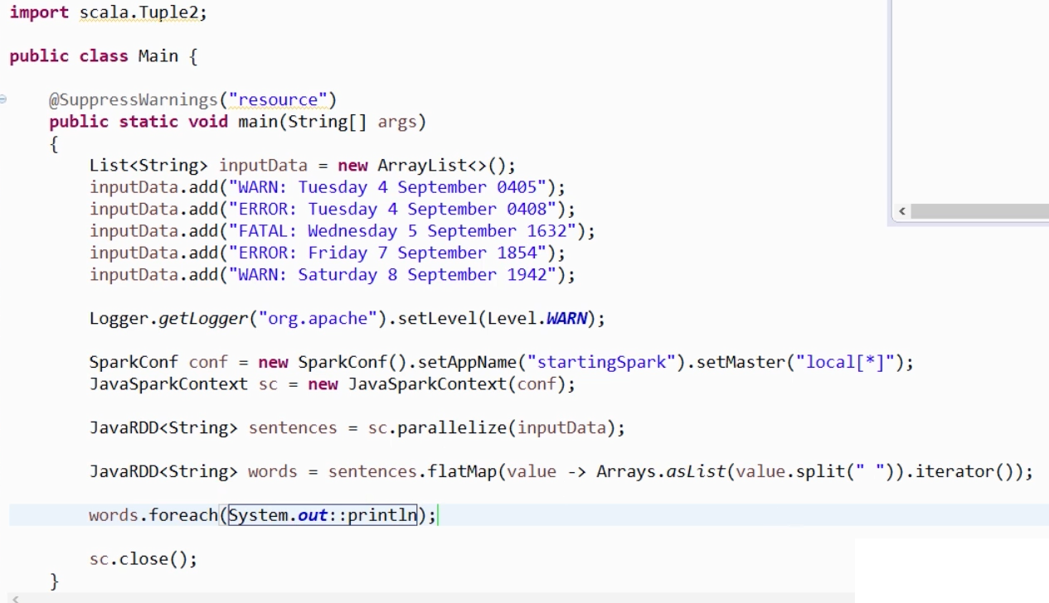

Slide 27
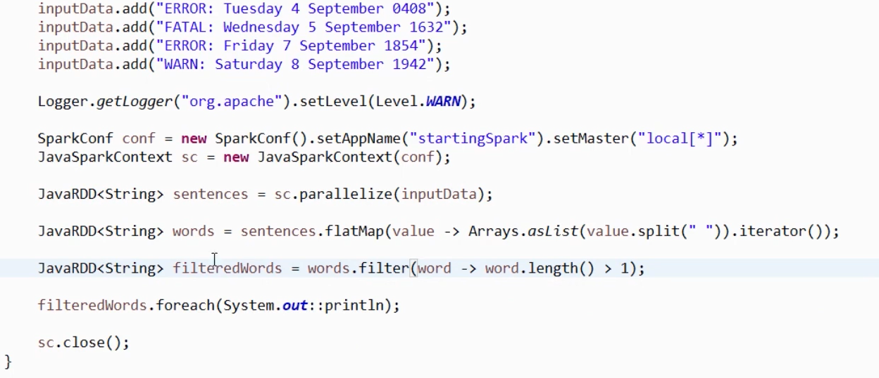
FILTER SINGLE CHARACTER FROM DATA

Slide 28
proj

Slide 29
Loading this file as RDD get readoff all the boring words & count the words that are remaining
and then find the 10 most frequently used.

Slide 30
Take the subtitles file in (C:\\Users\\Manish\\Desktop\\spark_Eclipse\\SparkTraing\\target\\My_Data\\resources\\subtitles\\input.txt");
Wn input text file which is a set of subtitles.
we would like to be able to generate automatically a set of 10 key words for that course and
The keywords of course should reflect the major topics in that File.

Slide 31
split this file up into words and count each unique word that appears in this file.

Slide 32
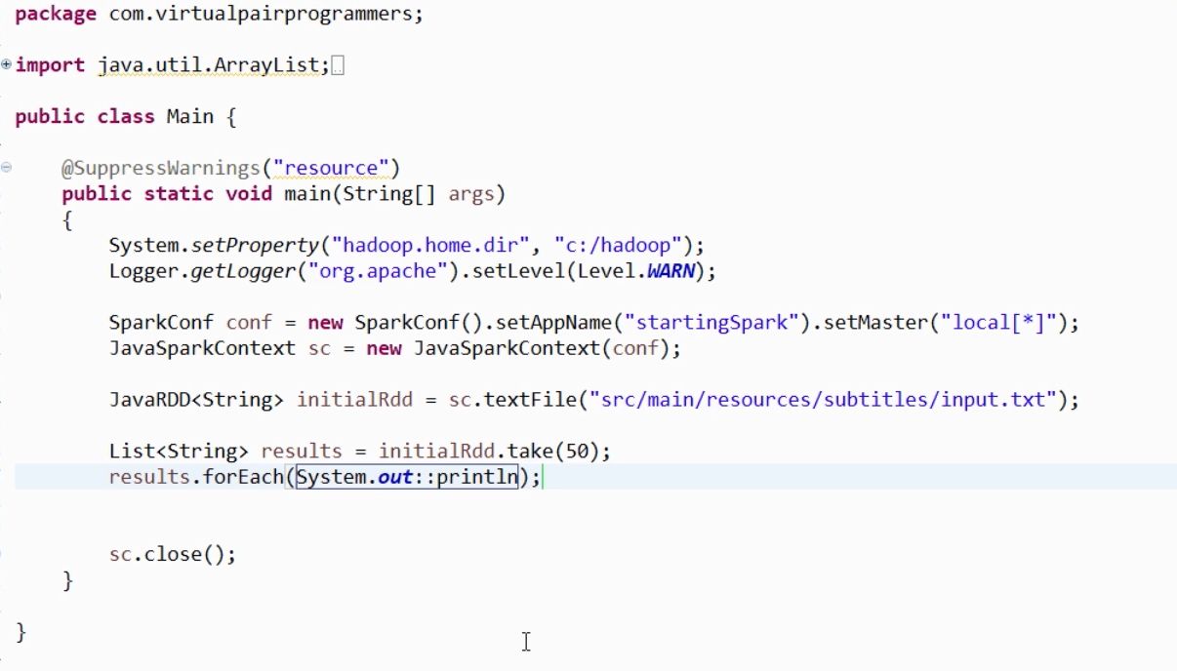

Slide 33
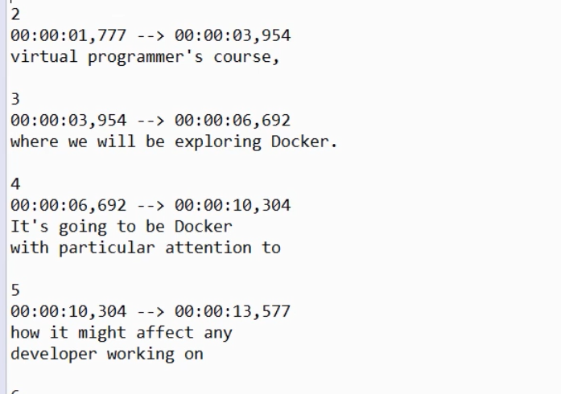
O/P
So all of these timestamps and the sequential number.
And if these blank lines are of no relevance to us it's all.
So how do we get rid of this redundant data.

Slide 34
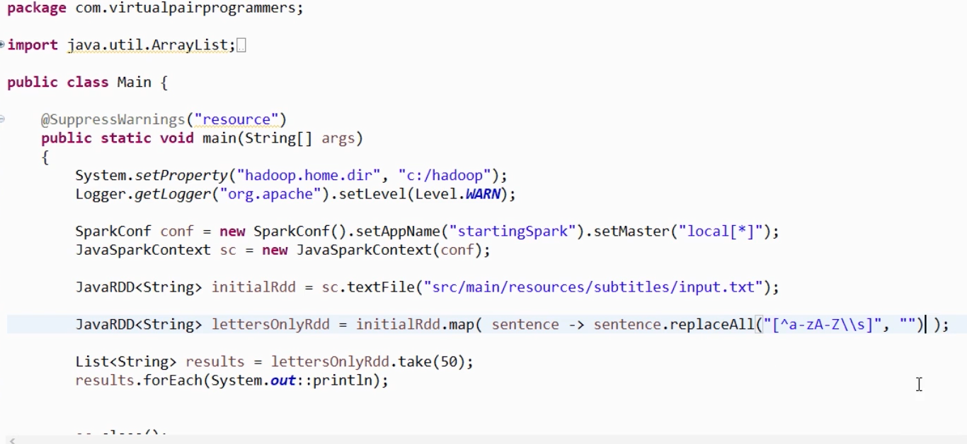
Removing Extra Characters

Slide 35
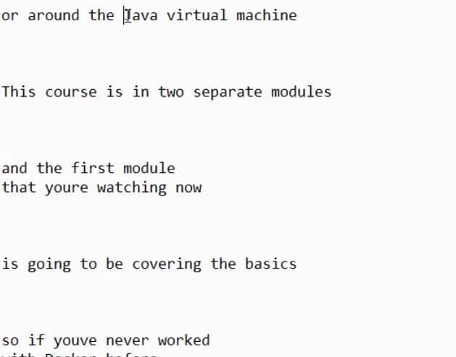

Slide 36
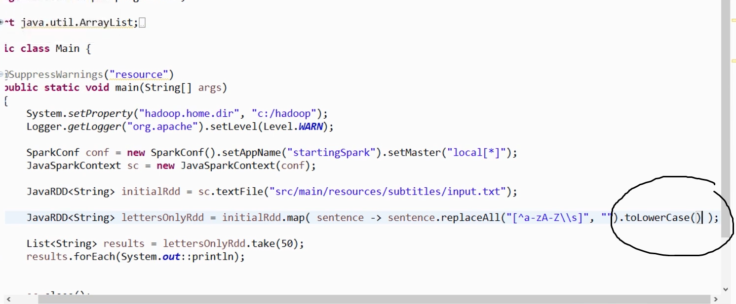
Now, All Lower Case /Upper Case

Slide 37
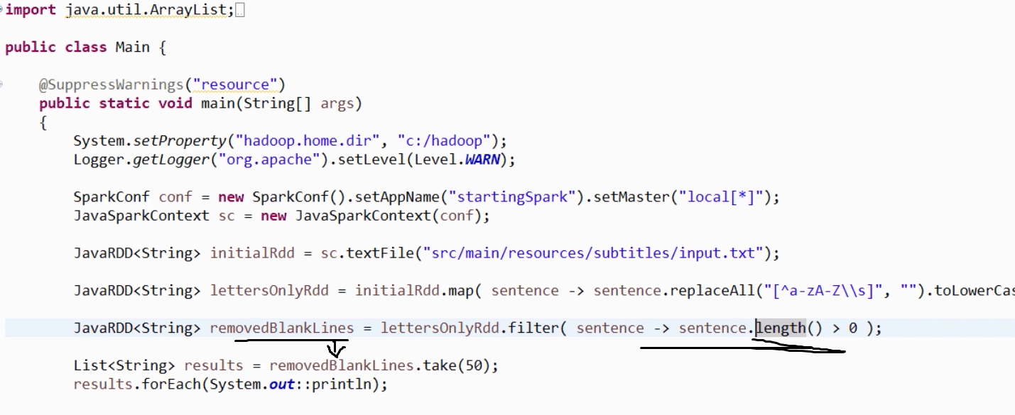
BLANLK LINE→ How to Filter Out

Slide 38
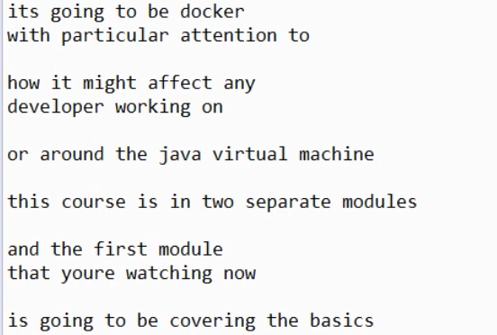
There are Still Some more Black Lines

Slide 39
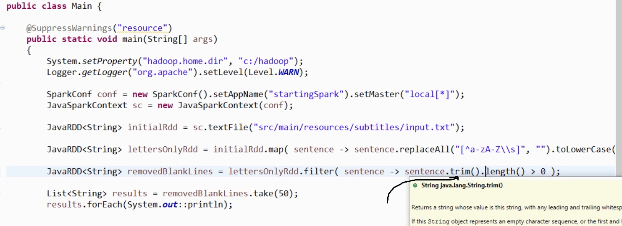

Slide 40
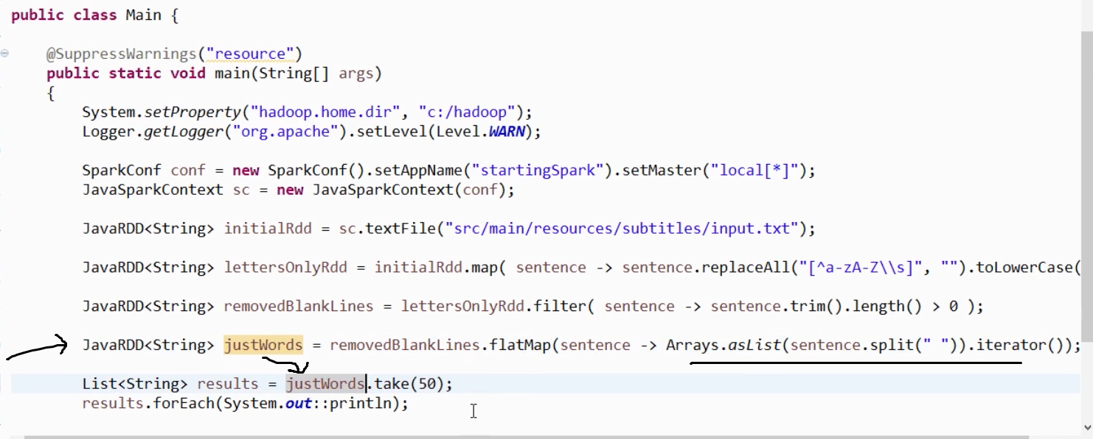
FLATMAP

Slide 41
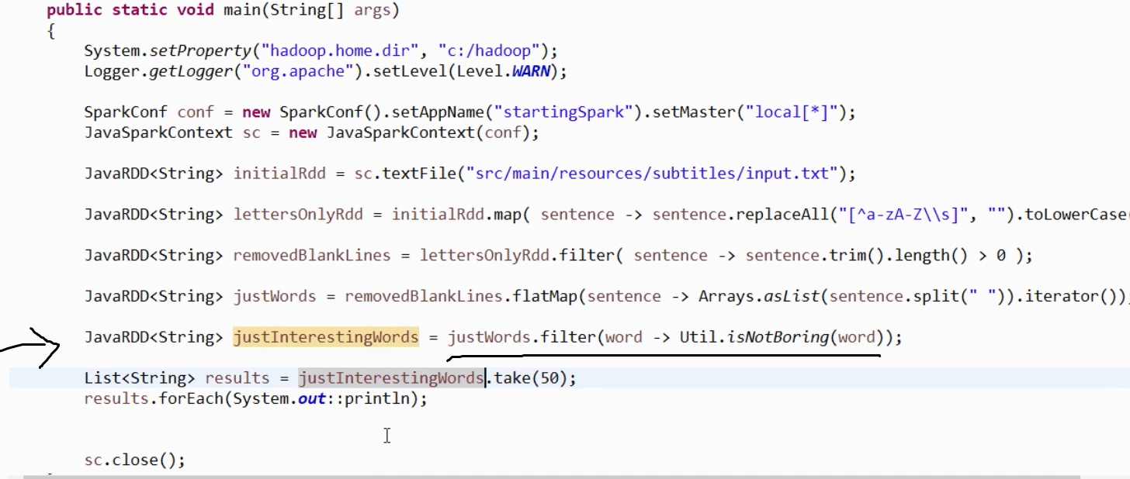
Now, Filter Out Boring Words

Slide 42
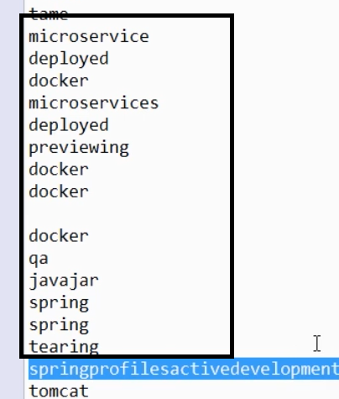

Slide 43
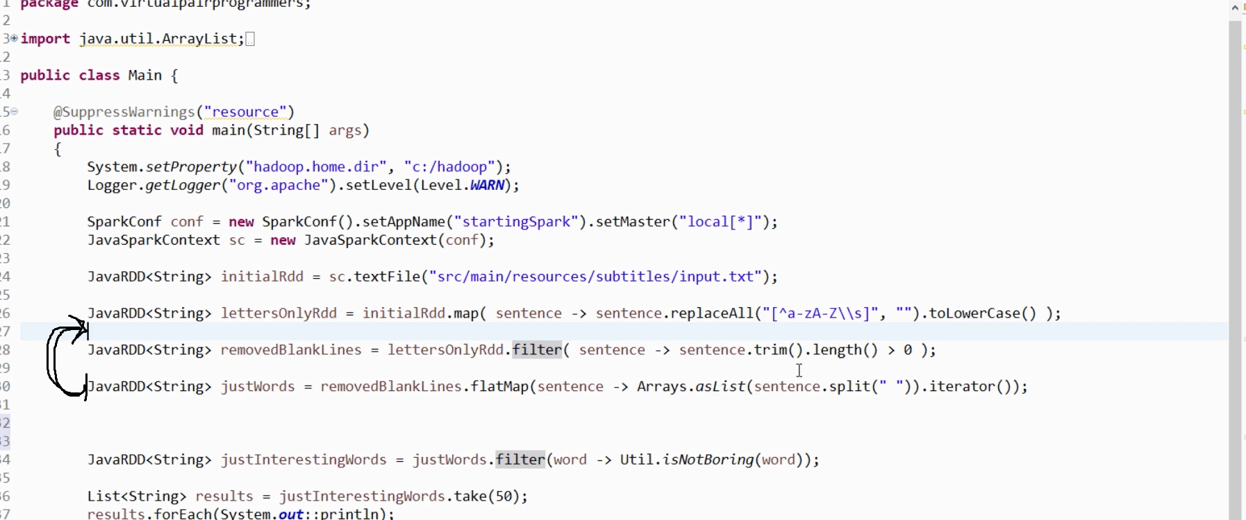
Just Reorder the Operation

Slide 44
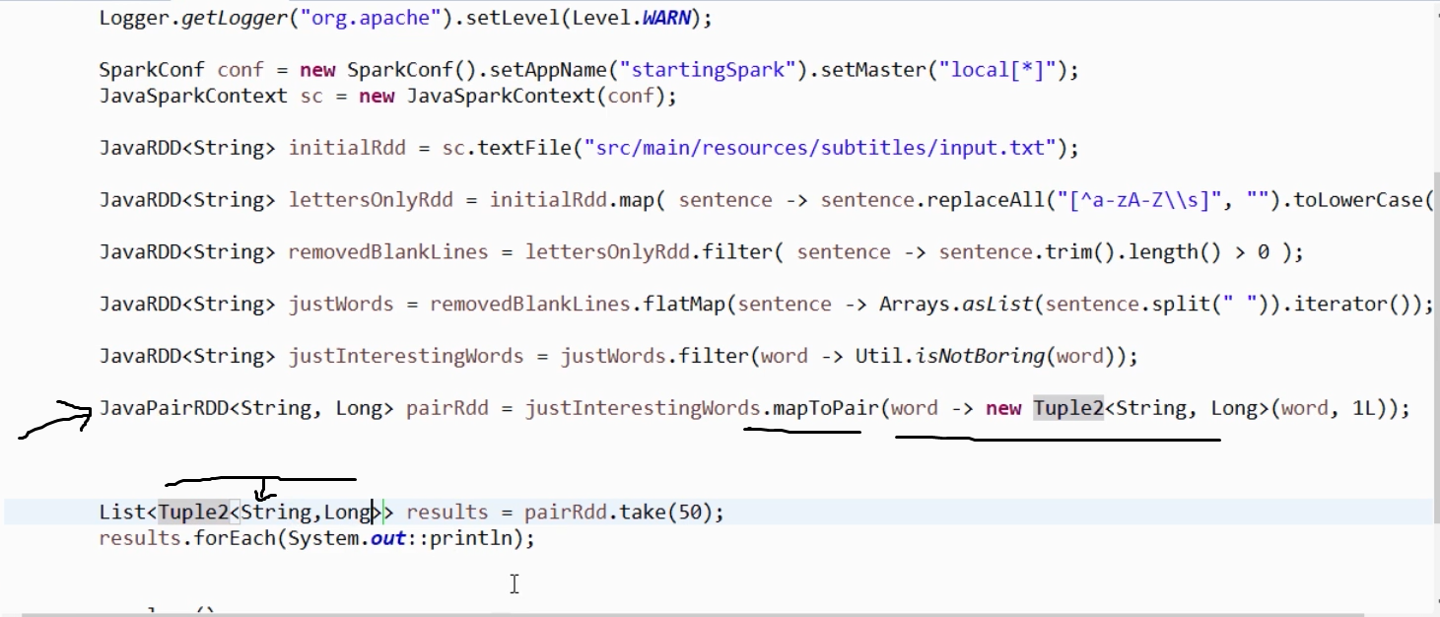
Now, Convert it To PAIR RDD

Slide 45
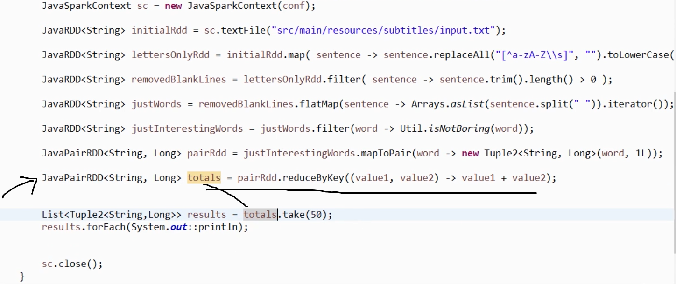
Apply REDUCE BY Key

Slide 46
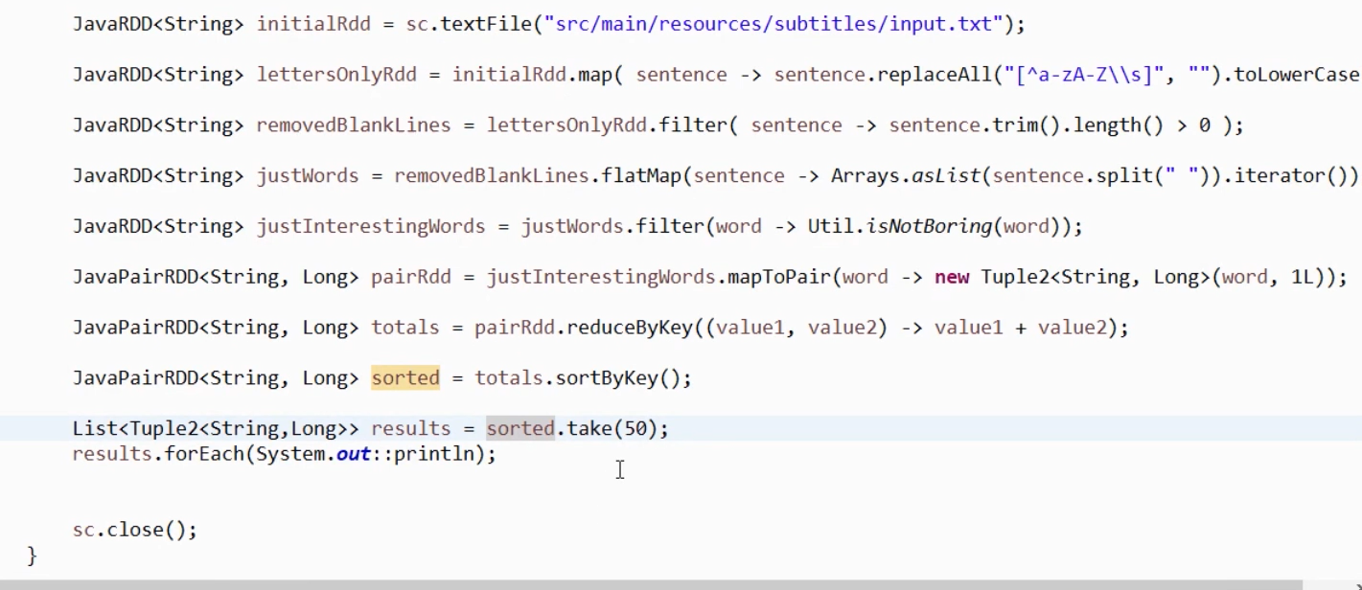
Now, Sort Them ( SortByKey)

Slide 47
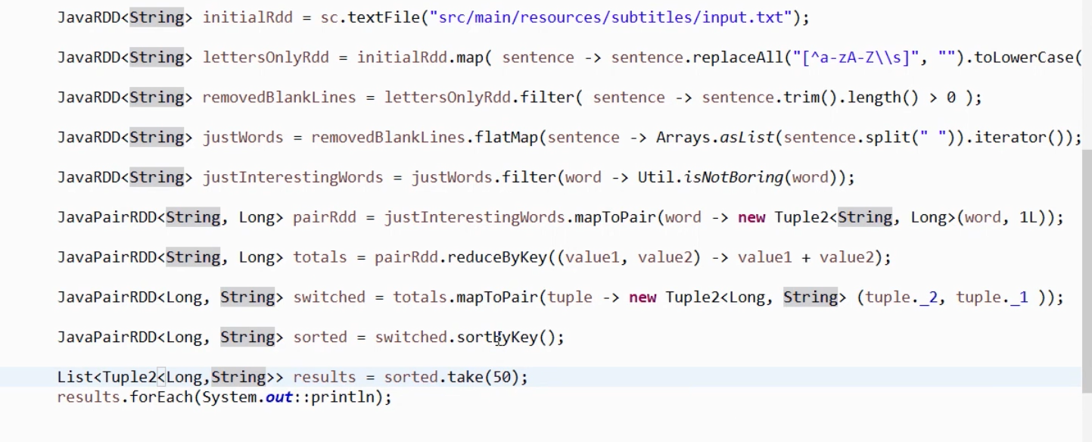
How to Do Sort By Value

Slide 48
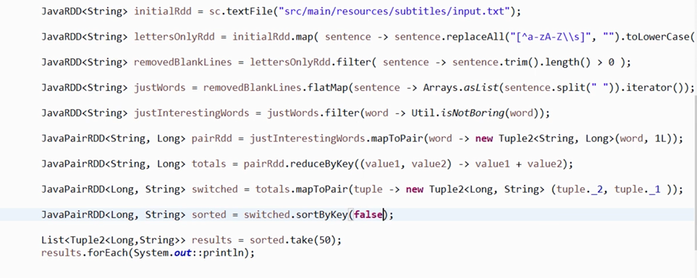
How to Make ascending Order /Descending

Slide 49
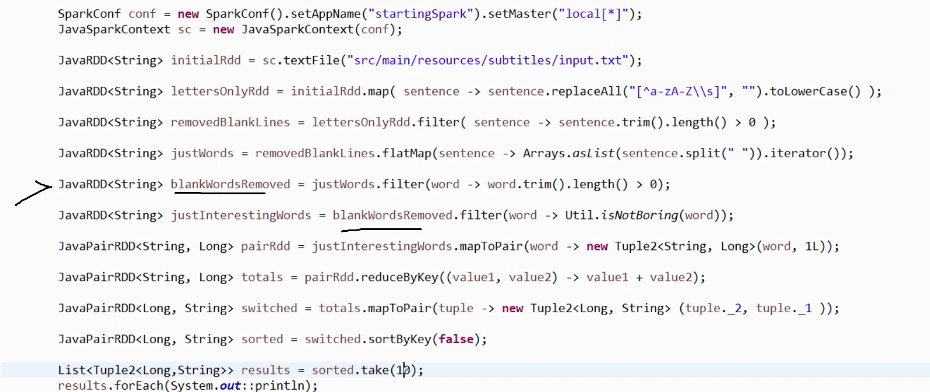
How to Remove Black Space Count Data

Slide 50
Sorts and Coalesce

Slide 51
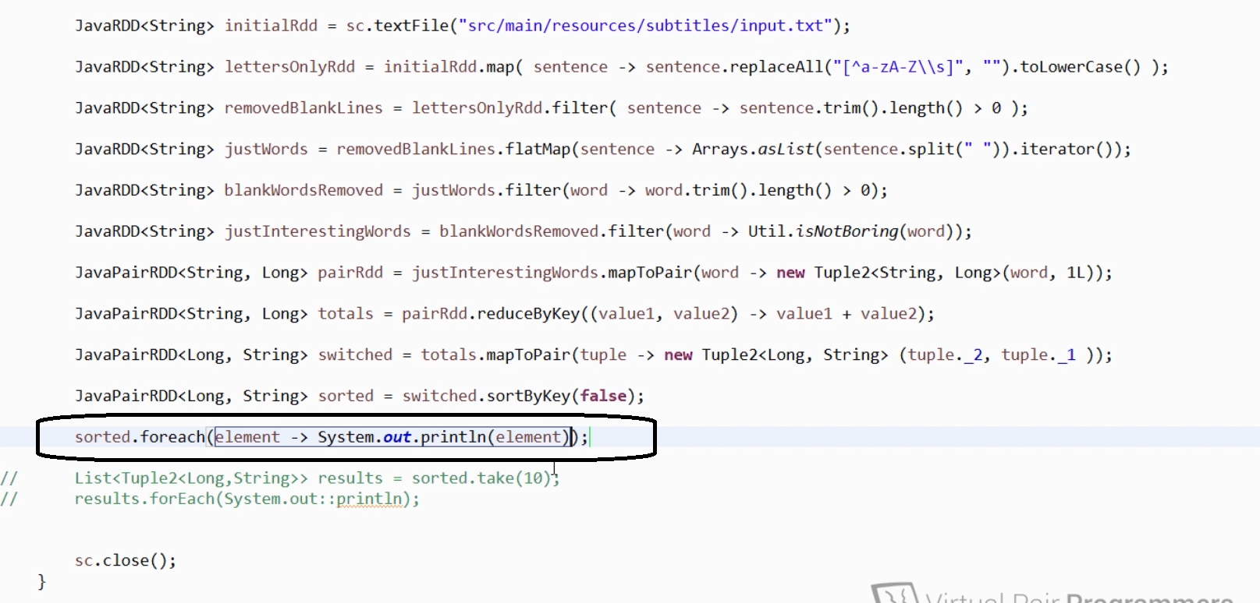
Instead of take → Foreach Method

Slide 52
Confused with Out Put????

Slide 53
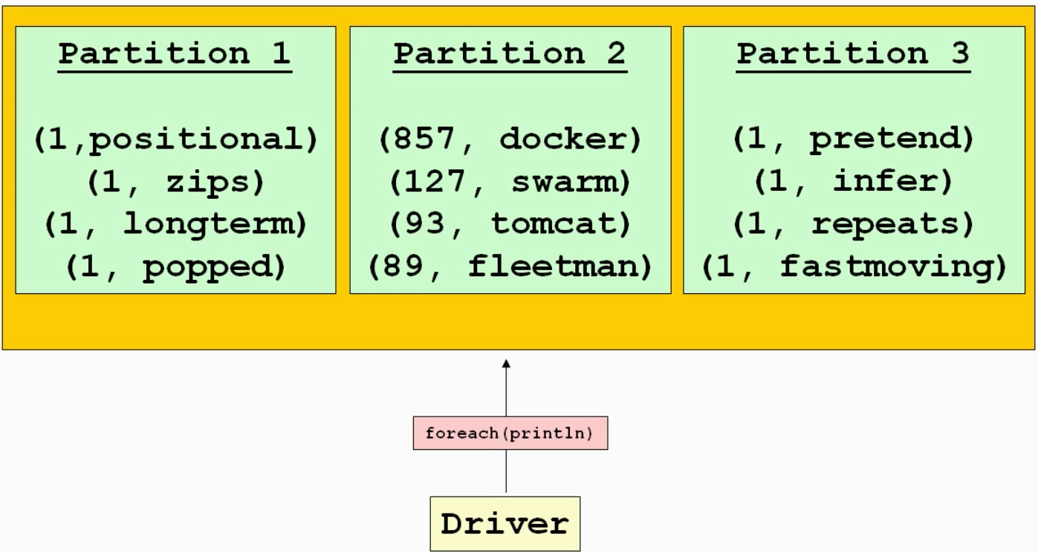

Slide 54
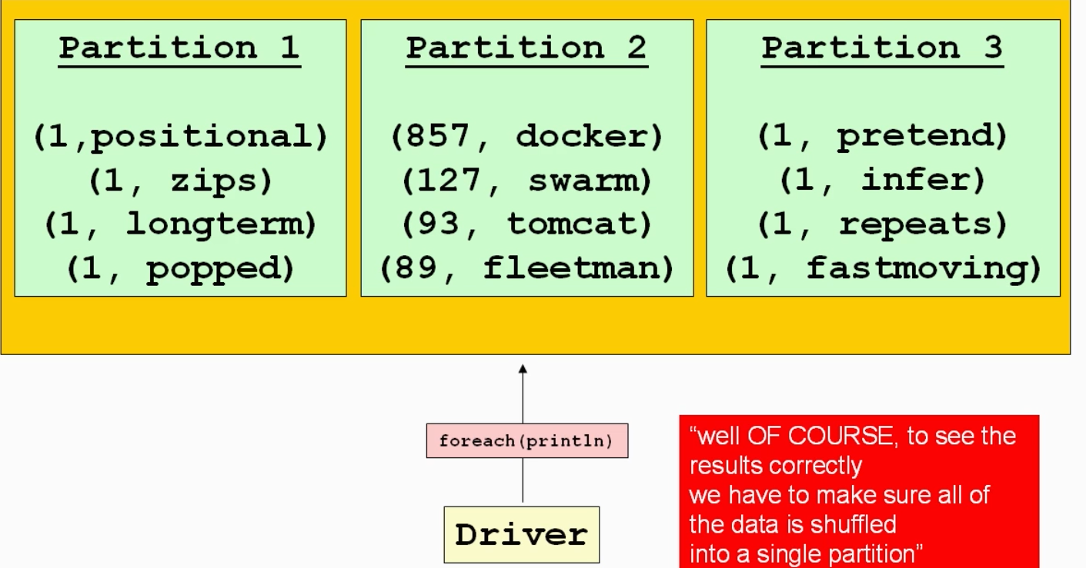

Slide 55
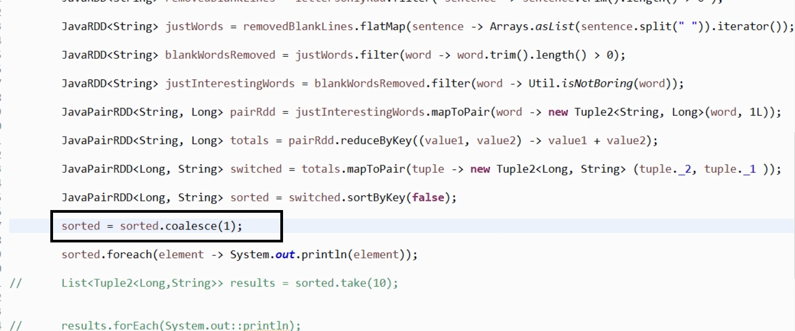
COALESCE

Slide 56
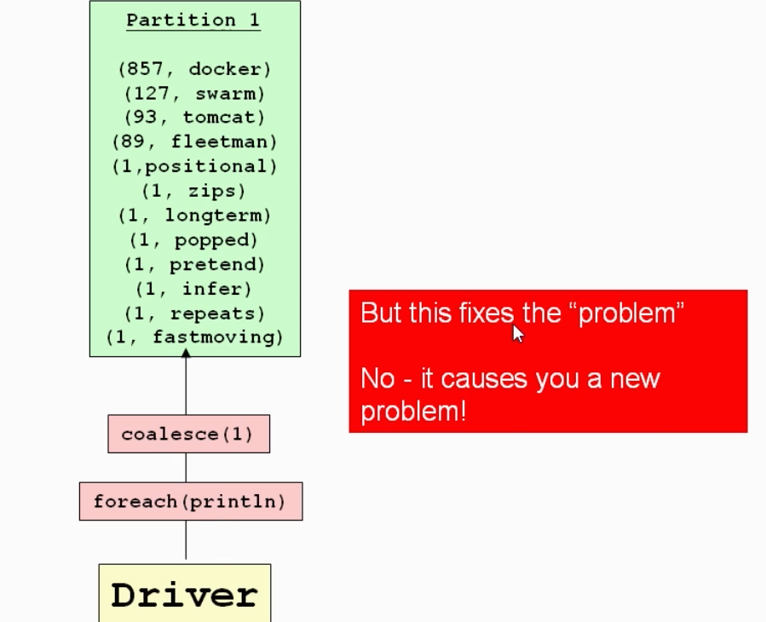
Coalesce

Slide 57
Remove CoalEsce & Run

Slide 58
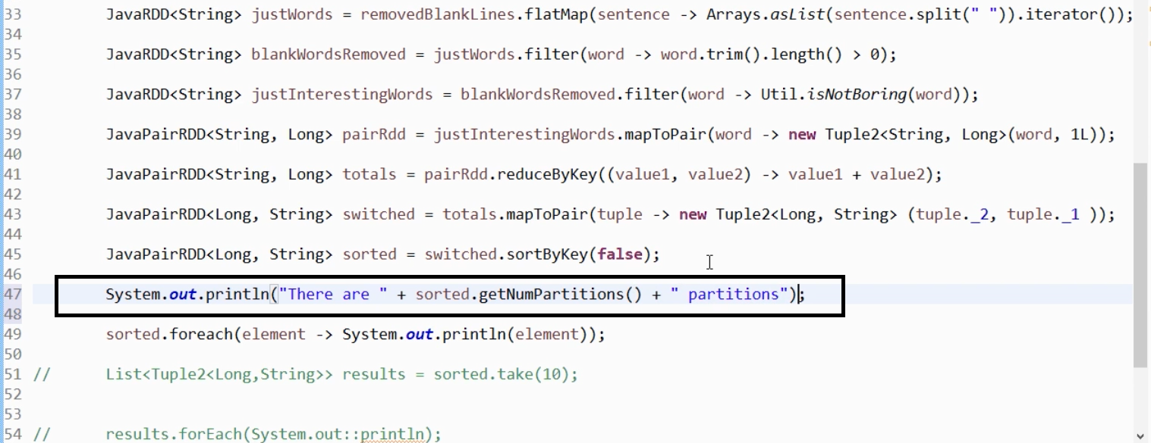
Check No of Partitions

Slide 59
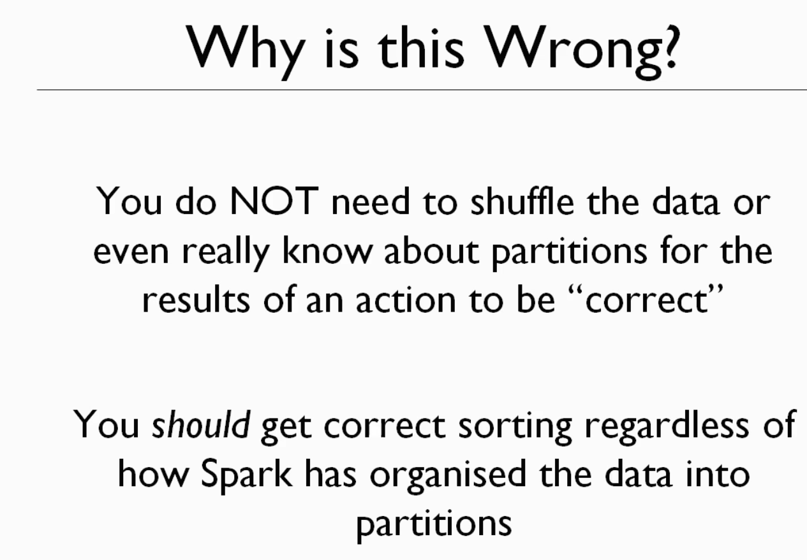

Slide 60
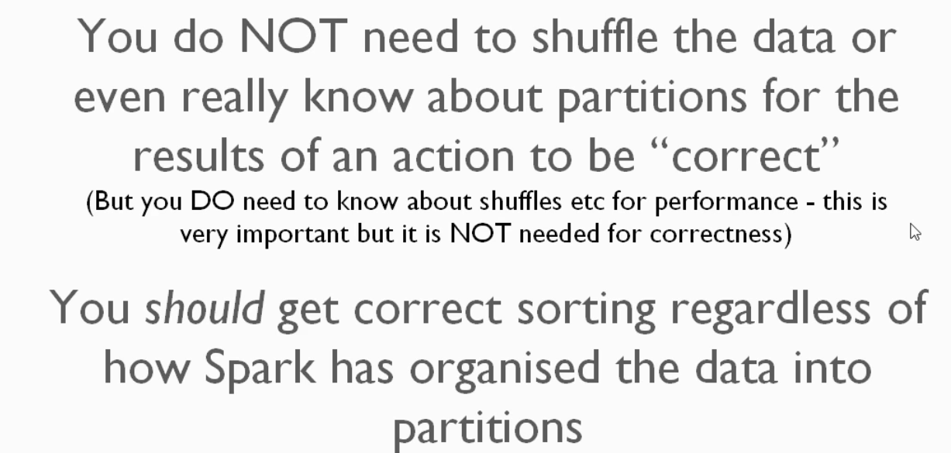

Slide 61
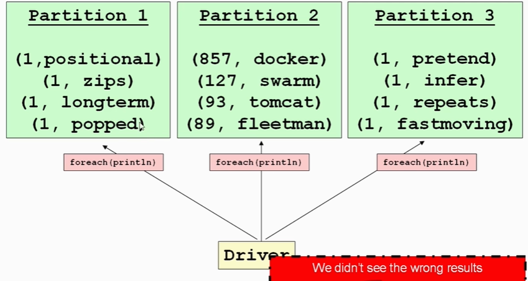
How Foreach Works ::::

Slide 62
foreach →be careful it's going to execute the lambda on each partition in parallel and in parallel will mean threading.

Slide 63
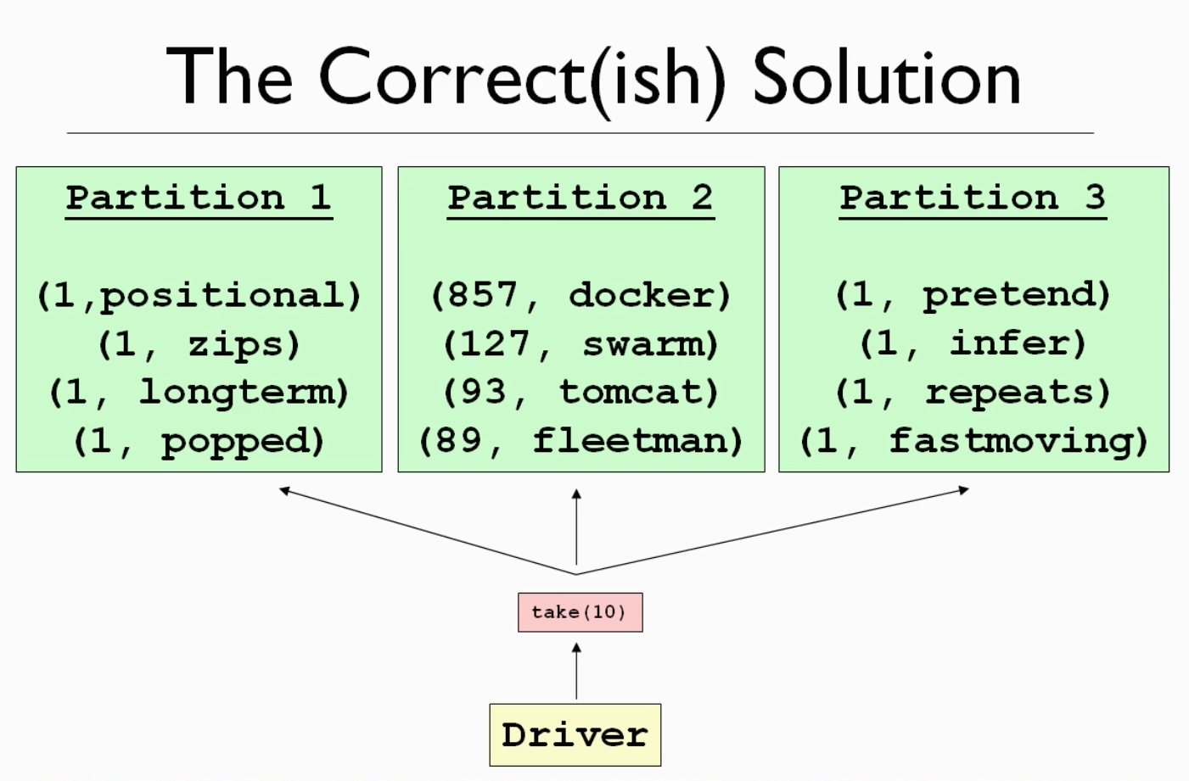
Any Action Apart from Foreach will Give Correct Answer

Slide 64
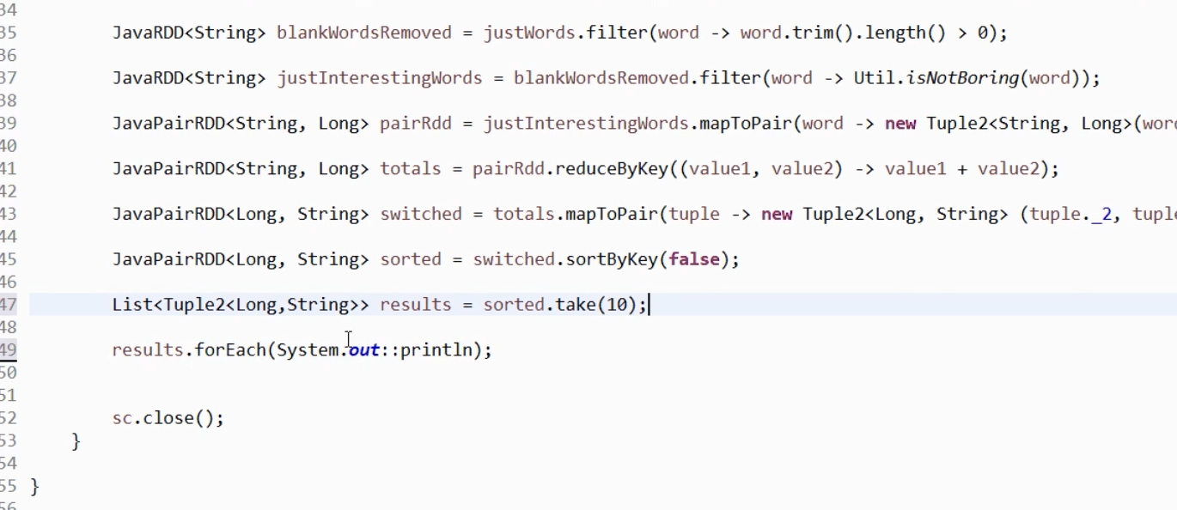

Slide 65
Why COALESCE ???

Slide 66
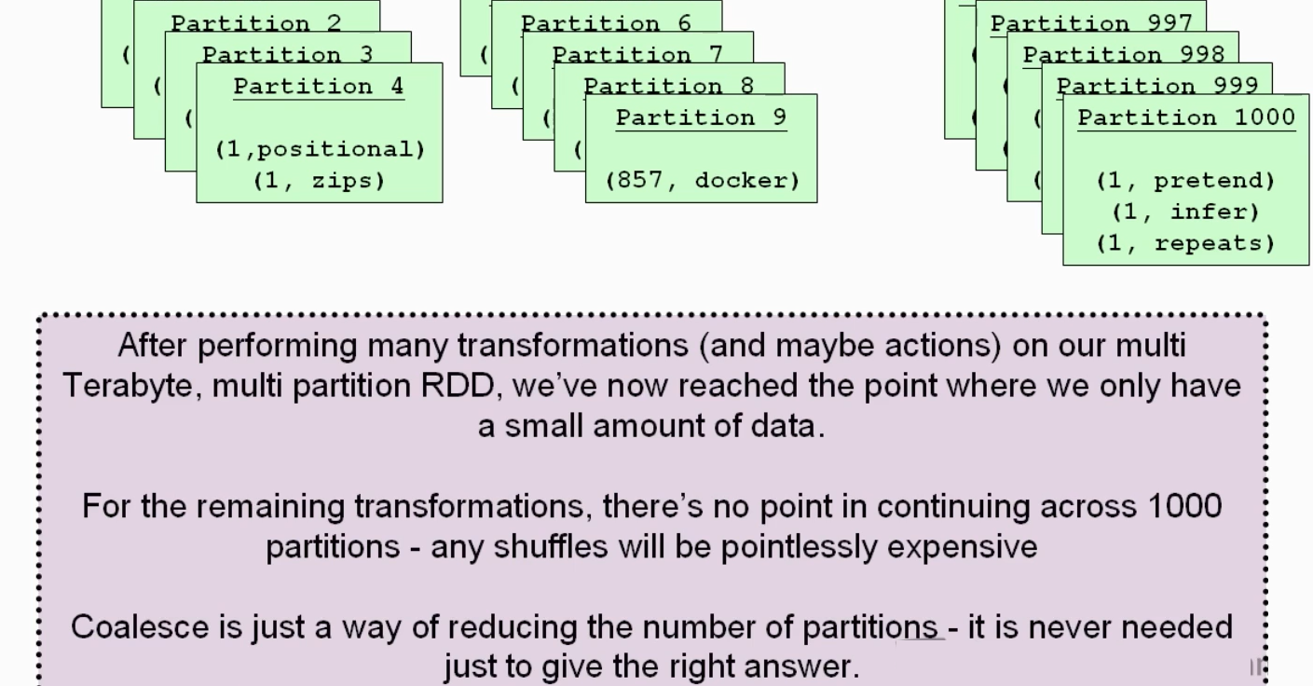

Slide 67
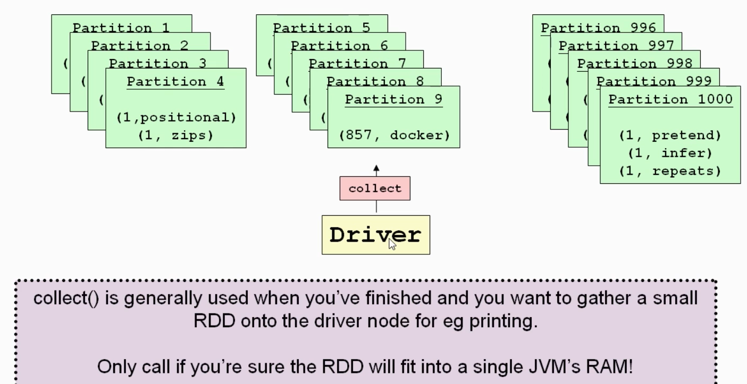
COLLECT METHOD

Slide 68



JOIN
Rdd1 rdd2

Slide 69

Its Kind of TUPLE

Slide 70


Slide 71


Slide 72


Slide 73



Slide 74

Modern SYNTAX
nulls are problematic because you might cause a null pointer exception later on if you try to do something
with this value.
So the idea of optionals is that wrappers for objects and in the case of use right before you will get
back an optional object put in sight that objects will be the object that you want.
want.
And for the user ID 10 we will still get an object so we won't see a null pointer exception and we can
query that object.
We can ask if the object actually has a value or not.
And it certainly does complicate the tie here on the left hand side.

Slide 75



Slide 76

Next:: I want Each Element in RDD should Print in UPPER CASE
e as to the kinds of flexibility and richness of this functional style
of programming where you're not working with nulls anymore you're always working with objects.
So just in a single line I could deal with the possibility of blanks there.

Slide 77



Slide 78


Slide 79


Slide 80



Slide 81

CARTESIAN PRODUCT

